Slide 1
Creating the Canvas
Notes:
Hi! In this lesson, we’re going to look at how we can create graphics using Python. Let’s get started!

Slide 2
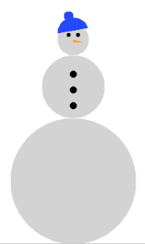
How do we create graphics?
We can use tkinter to draw graphics in Python.
Tkinter is the standard Python interface to the Tk GUI toolkit.
Many more uses!
Notes:
In order to create graphics in Python, we need to use an interface called Tkinter. Though there are other ways we can create graphics in Python, Tkinter is the standard Python interface to the TK GUI toolkit and the one we’re going to focus on in this course.
We’re going to be using Tkinter to draw shapes on the canvas, such as the snowman shown here, but there are many other things that can be created using this interface, such as buttons, text inputs, and other widgets. You can find more information about Tkinter in the link in the DOCs tab.

Slide 3
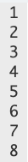
How do we create graphics?
This is the template we will use to create our graphics programs.
from tkinter import *
root = Tk()
mainloop()
We will write commands here to create shapes.
Notes:
In order to use Tkinter, we need to import the library at the beginning of our program. To do this, we simply type ‘from tkinter import *’. The star tells the computer to import all of the items found inside the tkinter library. We then write master = Tk() and add our commands underneath. At the end of our program, we type mainloop() to run all of our commands. This template will be provided for you as a starter code for any graphics programs we write so you don’t have to memorize it.

Slide 4
Coordinate System
(0,0)
x
y
Notes:
Before we begin writing programs, let’s take a look at the coordinate system we’ll be using with Python Graphics. As you can see, the 0,0 point is located in the top left-hand corner. The x values increase as we move right and the y values increase as we move down.

Slide 5
Coordinate System
(0,0)
x
(200, 0)
y
Notes:
For example, this point would be located at 200 in the x direction and 0 in the y direction.

Slide 6
Coordinate System
(0,0)
x
(100, 150)
y
Notes:
And this point would be located at 100 in the x direction and 150 in the y direction.

Slide 7
Coordinate System
(0,0)
x
(400,0)
(100, 150)
y
(200,0)
Notes:
From these values, we can see that our canvas is 400 pixels wide and 200 pixels tall.

Slide 8
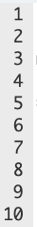
The Canvas
(0,0)
x
(400,0)
from tkinter import *
root = Tk()
# Create canvas
screen = Canvas(root, width=400, height=200)
screen.pack()
(100, 150)
y
(200,0)
Notes:
When we begin our programs, we can actually choose the size of the canvas we’re going to be drawing on. We do this by using the commands here, where we note the width and height values.

Slide 9
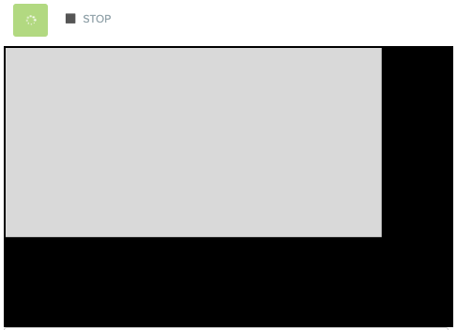
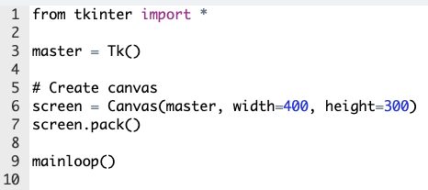
The Canvas
from tkinter import *
root = Tk()
# Create canvas
screen = Canvas(root, width=400, height=200)
screen.pack()
mainloop()
Notes:
When we run this program, we’ll see a canvas, which will default to a gray color, on our screen with the noted dimensions.

Slide 10
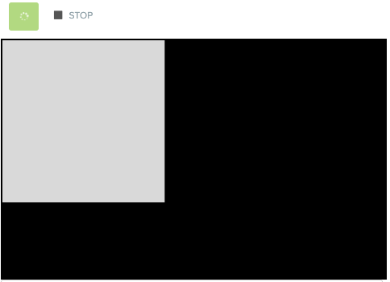
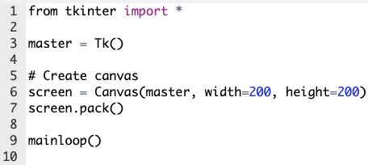
The Canvas
from tkinter import *
root = Tk()
# Create canvas
screen = Canvas(root, width=200, height=200)
screen.pack()
mainloop()
Notes:
If we instead used a height and width of 200, we would see a smaller canvas area.

Slide 11
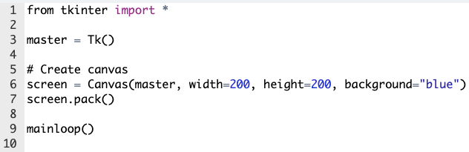
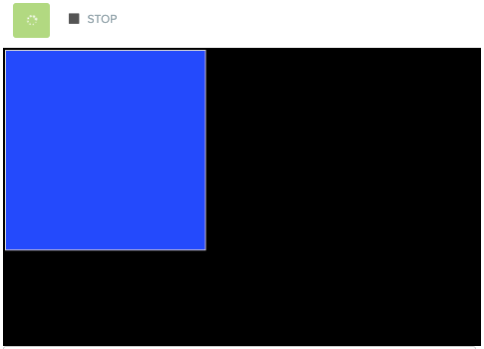
The Canvas
from tkinter import *
root = Tk()
# Create canvas
screen = Canvas(root, width=200, height=200, background="blue")
screen.pack()
mainloop()
Two ways to change color:
background = “color name”
bg = “color name”
Notes:
We can also change the background color of this canvas, because we obviously want to use colors other than gray! We can use one of the two attributes to change color, either using the word ‘background’ or simply the letters ‘bg’. We place color names inside quotation marks. Now let’s see how we can draw on our canvas.

Slide 12
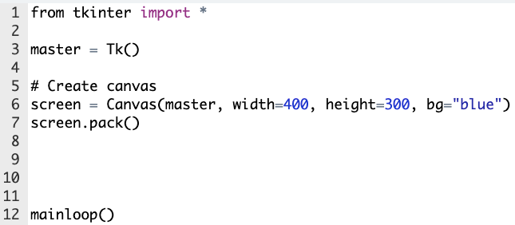
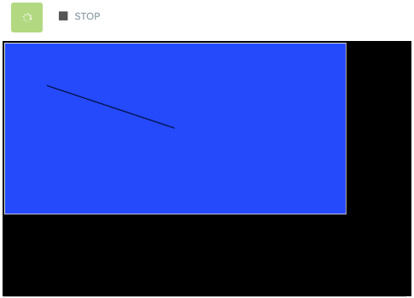
Creating Lines
To create a line:
screen.create_line(x1, y1, x2, y2)
from tkinter import *
root = Tk()
# Create canvas
screen = Canvas(root, width=400, height=200, bg="blue")
screen.pack()
screen.create_line(50, 50, 200, 100)
mainloop()
Notes:
We can draw a line from one point to another by giving the coordinates of the starting and ending points and using ‘screen.create_line()’.

Slide 13
Creating Lines
To create a line:
screen.create_line(x1, y1, x2, y2)
from tkinter import *
root = Tk()
# Create canvas
screen = Canvas(root, width=400, height=200, bg="blue")
screen.pack()
screen.create_line(50, 50, 200, 100)
mainloop()
(50, 50)
Notes:
The beginning point of our line is located at 50,50...

Slide 14
Creating Lines
To create a line:
screen.create_line(x1, y1, x2, y2)
from tkinter import *
root = Tk()
# Create canvas
screen = Canvas(root, width=400, height=200, bg="blue")
screen.pack()
screen.create_line(50, 50, 200, 100)
mainloop()
(50, 50)
(200, 100)
Notes:
And the ending point is at 200,100.

Slide 15

Creating Lines
To create a line:
screen.create_line(x1, y1, x2, y2, x3, y3, ...)
from tkinter import *
root = Tk()
# Create canvas
screen = Canvas(root, width=400, height=200, bg="blue")
screen.pack()
screen.create_line(50, 50, 200, 100, 50, 100)
mainloop()
(50, 50)
(50, 100)
(200, 100)
Notes:
Now, we can actually note as many points as we want inside our ‘create_line()’ function, and the points will just be drawn one after another. Here we’ve added the point 50, 100...

Slide 16
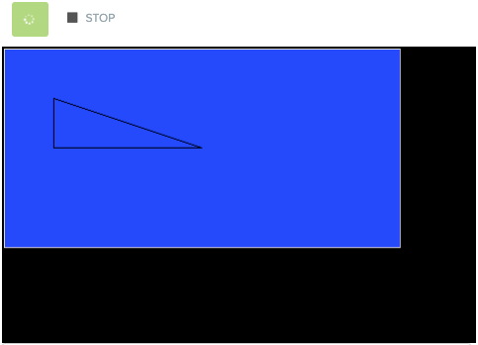
Creating Lines
To create a line:
screen.create_line(x1, y1, x2, y2, x3, y3, ...)
from tkinter import *
root = Tk()
# Create canvas
screen = Canvas(root, width=400, height=200, bg="blue")
screen.pack()
screen.create_line(50, 50, 200, 100, 50, 100, 50, 50)
mainloop()
(50, 50)
(50, 100)
(200, 100)
Notes:
And if we wanted to close the shape, we would simply add the first point to the end of our list. Here we’ve added 50, 50 to close our triangle.

Slide 17
Commands learned this lesson
Command | What does it do?
screen = Canvas(root, width=number, height=number) | Creates a canvas with the given dimensions
background= “color name” OR bg= “color name” | Attribute that colors the background of the canvas
screen.create_line(x1, y1, x2, y2) | Creates a line
screen.create_line(x1, y1, x2, y2, x3, y3, ...) | Creates a line to all given points

